Slide 1


HIRING PROCESS ANALYTICS
HIRING
PROCESS
PROJECT
BY
Kartik Arora
SUBMITTED BY
ANIKET ROY
UG STUDENT AT NIT AGARTALA
EMAIL.ID: ROYANIKET232001@GMAIL.COM

Slide 2
PROJECT DESCRIPTION:-
Hiring Process is very crucial thing that can affect the ultimate growth of a company. When an HR hire a candidate it is very important to hire that person on the basis of a lot of aspects as it is a mutual growth ais nd development of both the company and the person. So, Hiring should be done carefully.

Slide 3
APPROACH:-
Download the dataset
Approach the solution by performing MS Excel formulas.
Analyze the solutions.
Note them down.

Slide 4


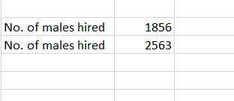
A. HIRING: PROCESS OF INTAKING OF PEOPLE INTO AN ORGANIZATION FOR DIFFERENT KINDS OF POSITIONS. MY TASK: HOW MANY MALES AND FEMALES ARE HIRED ?

Slide 5
B. AVERAGE SALARY: ADDING ALL THE SALARIES FOR A SELECT GROUP OF EMPLOYEES AND THEN DIVIDING THE SUM BY THE NUMBER OF EMPLOYEES IN THE GROUP. YOUR TASK: WHAT IS THE AVERAGE SALARY OFFERED IN THIS COMPANY ?

Slide 6
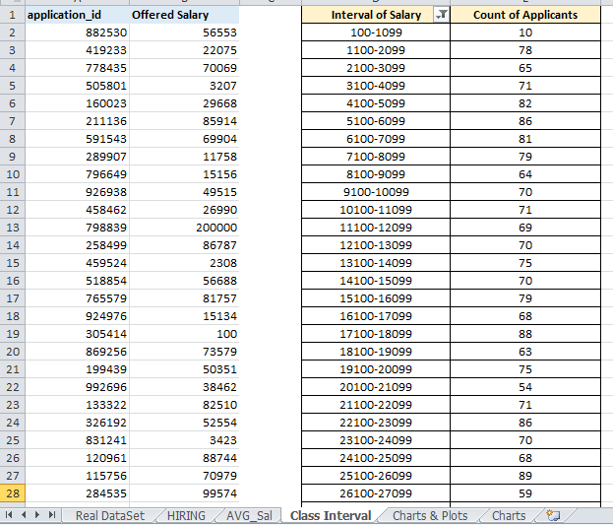
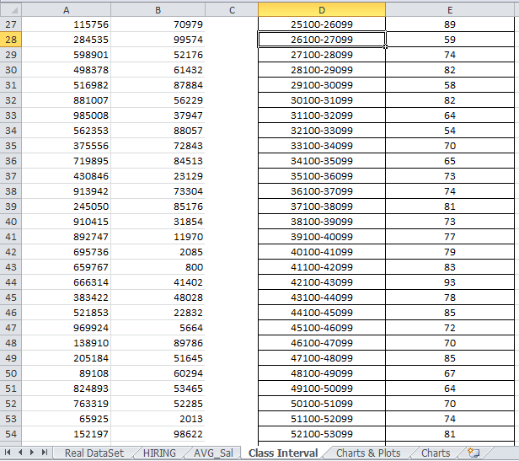
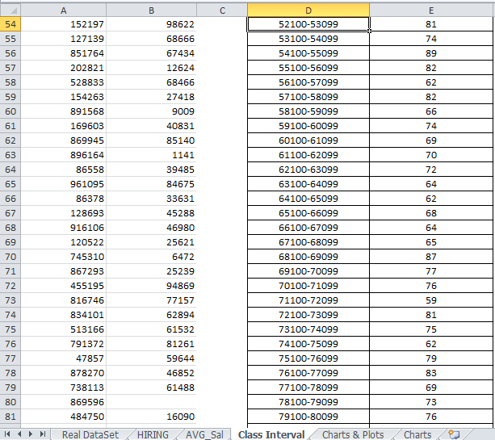
C. CLASS INTERVALS: THE CLASS INTERVAL IS THE DIFFERENCE BETWEEN THE UPPER CLASS LIMIT AND THE LOWER CLASS LIMIT. YOUR TASK: DRAW THE CLASS INTERVALS FOR SALARY IN THE COMPANY ?

Slide 7
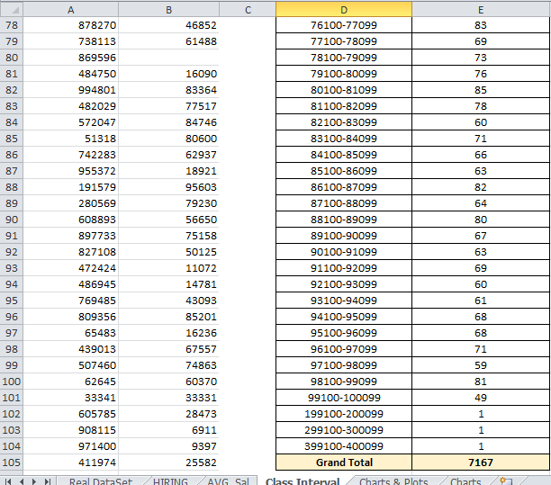

Slide 8
D. CHARTS AND PLOTS: THIS IS ONE OF THE MOST IMPORTANT PART OF ANALYSIS TO VISUALIZE THE DATA. YOUR TASK: DRAW PIE CHART / BAR GRAPH ( OR ANY OTHER GRAPH ) TO SHOW PROPORTION OF PEOPLE WORKING DIFFERENT DEPARTMENT ?
Using a Bar Graph in order to visualize the respective number against each department.
The first step would be to use the above formula against all the different departments in order to find out the number of employees under each of them.
Creating table to showcase the same

Slide 9
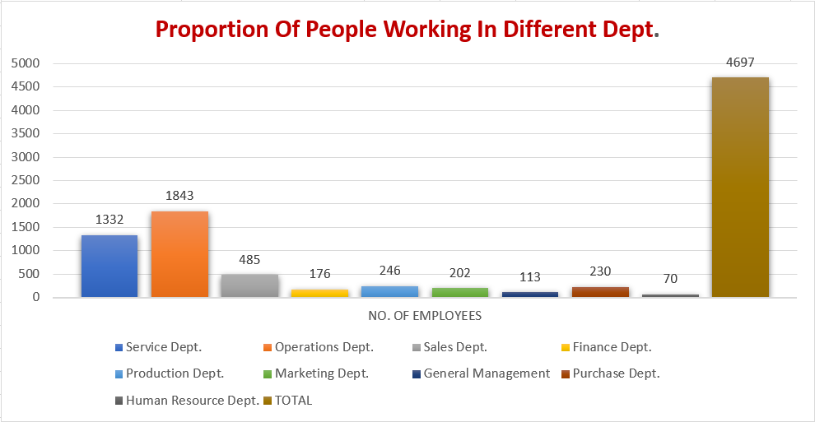
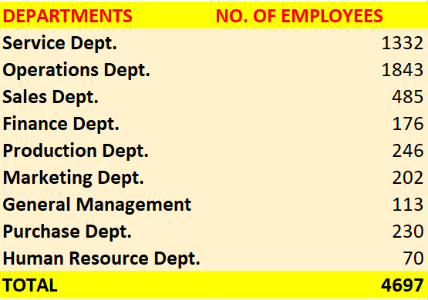
PROPORTION OF PEOPLE WORKING IN DIFFERENT DEPT.

Slide 10

CHARTS: USE DIFFERENT CHARTS AND GRAPHS TO PERFORM THE TASK REPRESENTING THE DATA. YOUR TASK: REPRESENT DIFFERENT POST TIERS USING CHART/GRAPH?
The first step would be to use the above formula against all the different Post Tiers in order to find out the number of employees under each of them.
Creating table to showcase the same.
Using a Bar Graph in order to visualize the respective number against each Post Tier.

Slide 11
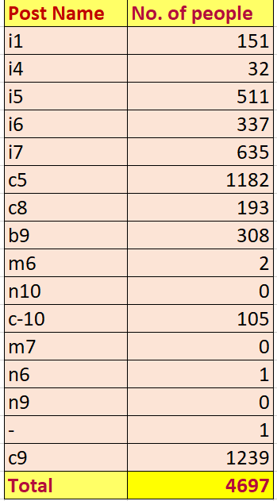
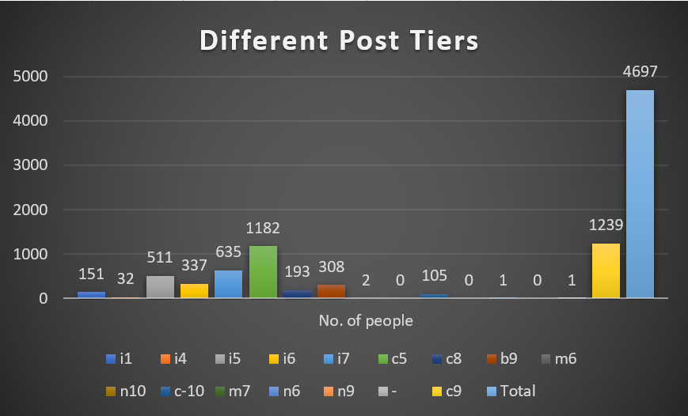
BAR GRAPHS

Slide 12
RESULT
No. of Males Hired=2563; No. of Females Hired=1856
Average Salary=49983.03

Slide 13
Thank you..

